Slide 1


Presentation on Vehicle License Plate Recognition (VLPR)
Guided By: Presented By:
Prof. Deepak Singh Chouhan Aditi Modi
Aditi Tiwari
Himanshu Patidar
Sejal Bhawsar

Slide 2
Contents
Introduction
1.1 Overview
1.2 Purpose
Requirement Engineering
2.1 Requirement Collection
2.2 Functional Requirements
2.3 Non Functional Requirements
2.4 Use Case Diagram
Technical Design
3.1 Technical Architecture
3.2 Sequence Diagram
3.3 Class Diagram
3.4 DFD
User Interface Design
Data Design
5.1 Schema Design
5.2 E-R Diagram
REFERENCES

Slide 3
1. Introduction
1.1 Overview
The Vehicle License Plate Recognition (VLPR) system is a Python-based computer vision project that detects and reads vehicle plates in real time. Using OpenCV for image processing, YOLOv8 for vehicle detection, and EasyOCR for text extraction, it captures video frames, isolates license plate regions, and converts them into structured data. With ~250 ms processing speed, multi-vehicle detection, character segmentation, and error correction, it supports applications like traffic monitoring, parking management, toll collection, and automated vehicle identification.
Key Features:
Real-time processing (~250 ms per frame).
Multi-vehicle detection and character segmentation (HSV color space).
Post-processing error correction for higher accuracy.
1.2 Purpose
Automated Vehicle Identification: Provides a fast, efficient way to identify and track vehicles in real time, removing the need for manual monitoring.
Accuracy & Efficiency: Enhances recognition speed, reliability, and reduces human error.
Advanced Technology Use: Leverages computer vision, OCR, and deep learning for precise multi-vehicle detection and rapid recognition
Practical Applications: Supports traffic monitoring, smart parking, toll collection, security surveillance, and automated vehicle entry.
Intelligent Transport Management: Transforms traditional traffic management into an intelligent, automated system.

Slide 4
2. Requirement Engineering 2.1 Requirement Collection
Identify Stakeholders:
Collect requirements from traffic police, parking management teams, and security administrators who need automated vehicle identification.
Understand User Needs:
Determine what users expect — such as real-time plate recognition, accuracy, data storage, and easy monitoring interface.
Study Existing Systems:
Analyze current manual or semi-automated vehicle tracking methods to identify gaps (e.g., slow processing, human errors).
Define System Inputs & Outputs:
Input – live video or camera feed.
Output – extracted license plate numbers stored/displayed in structured format.
Collect Technical Constraints:
Gather details about hardware (camera quality, lighting conditions) and software needs (processing speed, OCR performance, GPU usage).

Slide 5
2.2 Function Requirements
Detect vehicles in real time using the YOLOv8 model.
Identify and extract the license plate region from each vehicle.
Recognize plate characters using EasyOCR.
Display and store recognized plate numbers in a structured format.
Handle multiple vehicles simultaneously with high accuracy..

Slide 6
2.2 Non Functional Requirements
Performance: The system should process each frame within ~250 ms for real-time detection.
Accuracy: It must achieve high recognition accuracy (≥ 90%) under normal lighting.
Reliability: The system should work effectively despite noise, shadows, or partial plates.
Usability: The interface should be simple and easy for users to monitor results.
Maintainability: The code should be modular and easy to update or improve later.

Slide 7
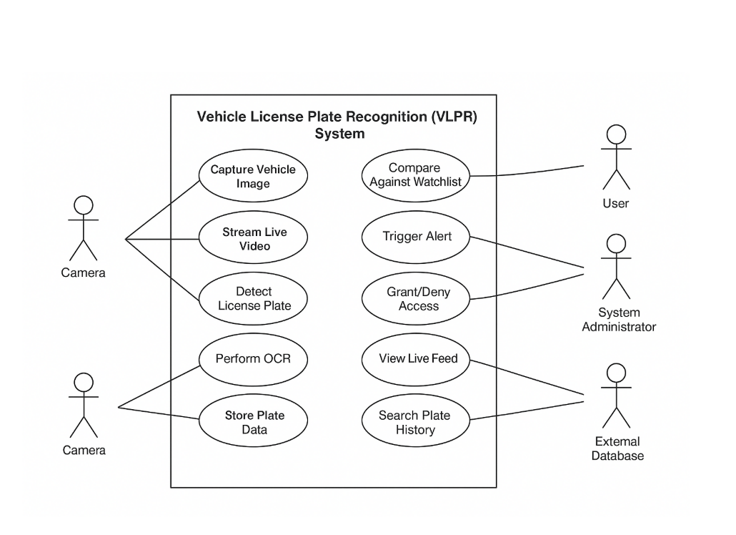
2.3 Use Case Diagram
System Use Case Diagram

Slide 8
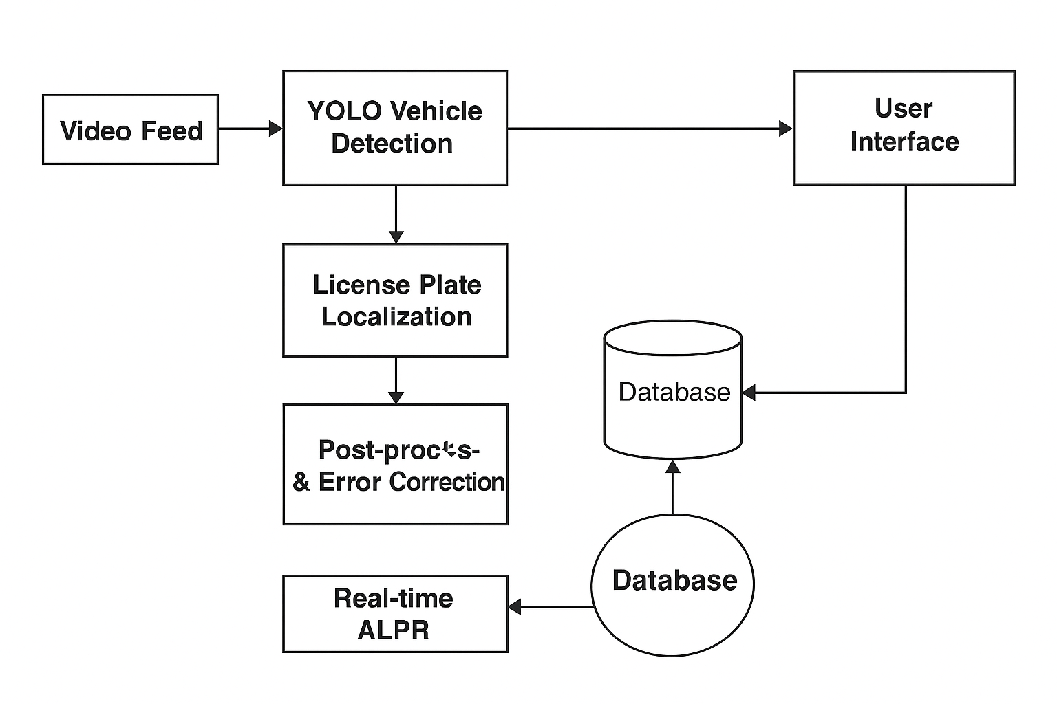
3. Technical Design 3.1 Technical Architecture
System Architecture Diagram

Slide 9
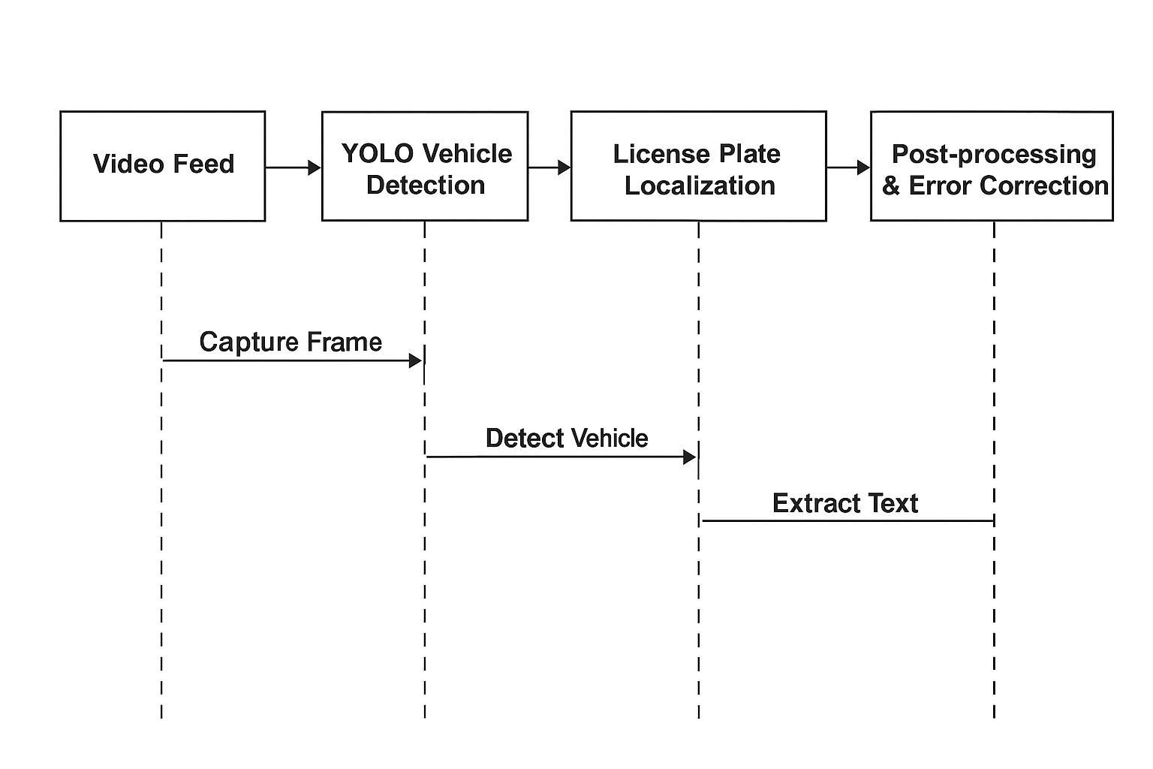
3.2 Sequence Diagram
System Sequence Diagram

Slide 10
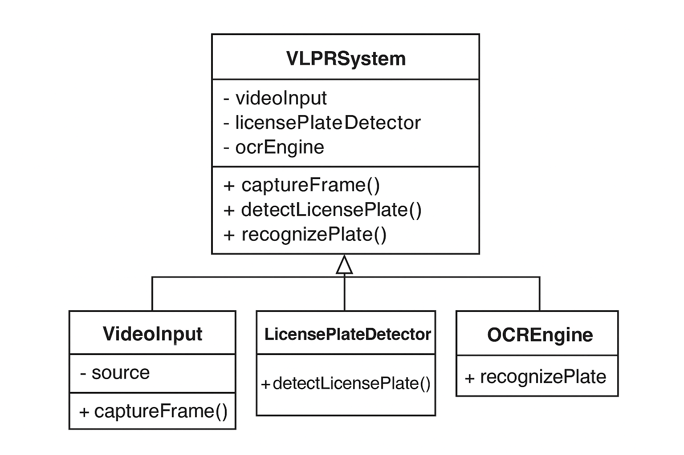
3.3 Class Diagram
System Class Diagram

Slide 11
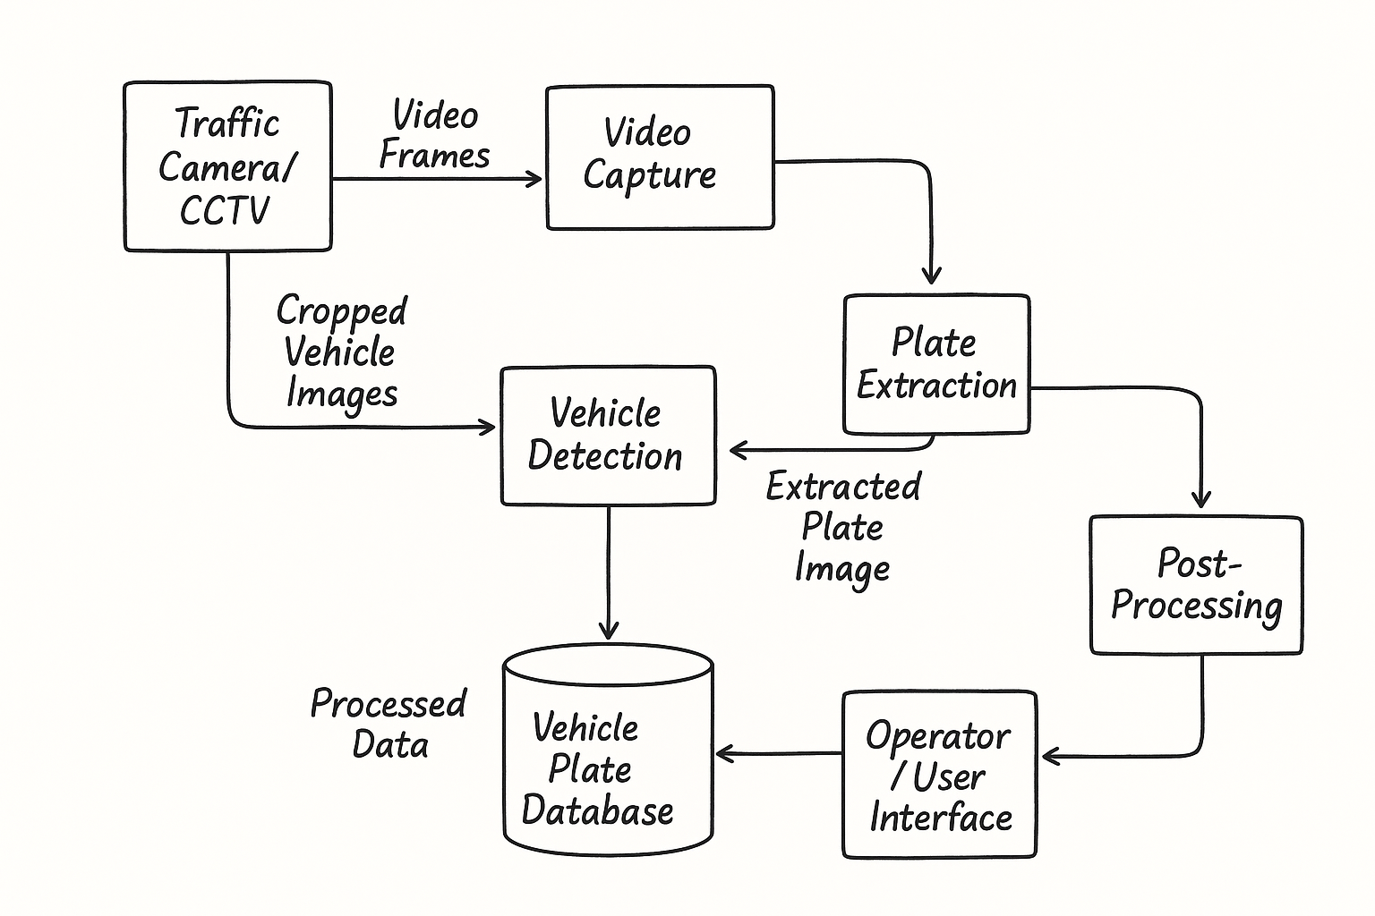
3.4 DFD
DFD Diagram

Slide 12
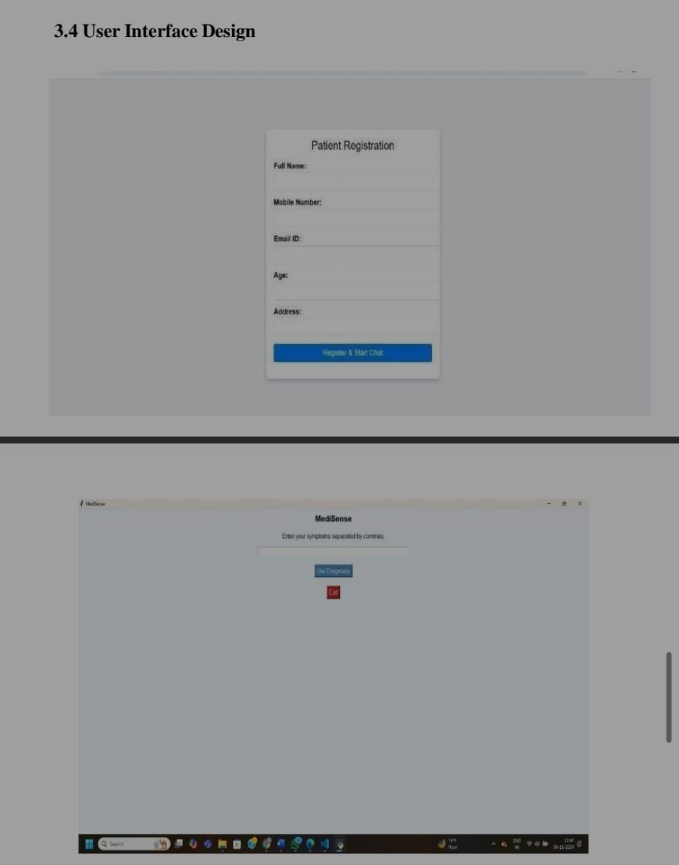
4. User Inface Design

Slide 13
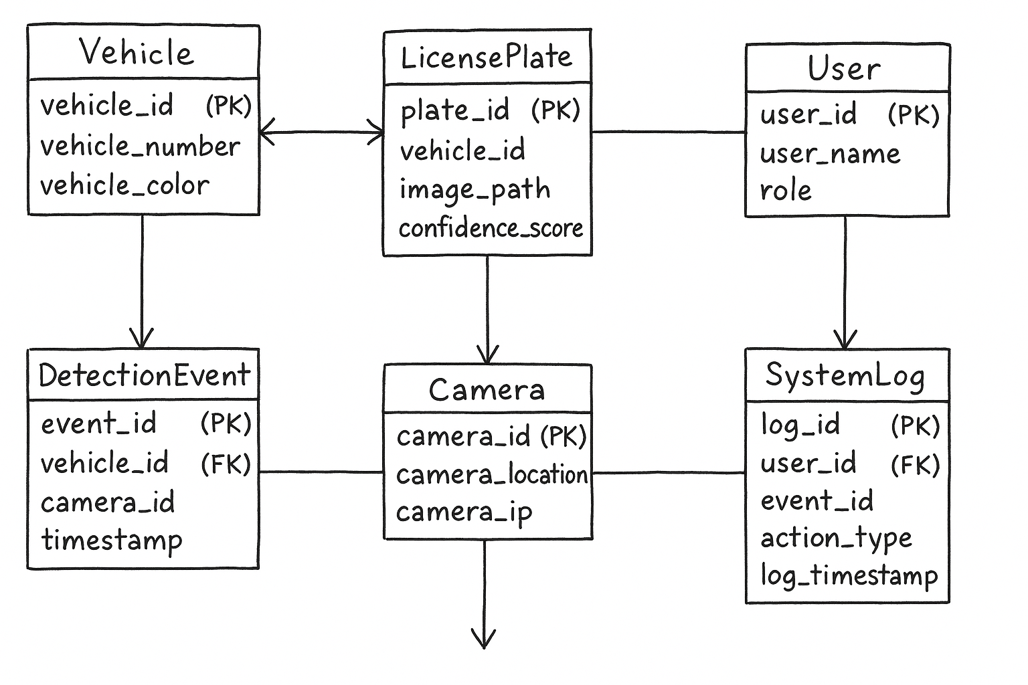
4. Data Design 4.1 Schema Definition
Complete Database Design.

Slide 14
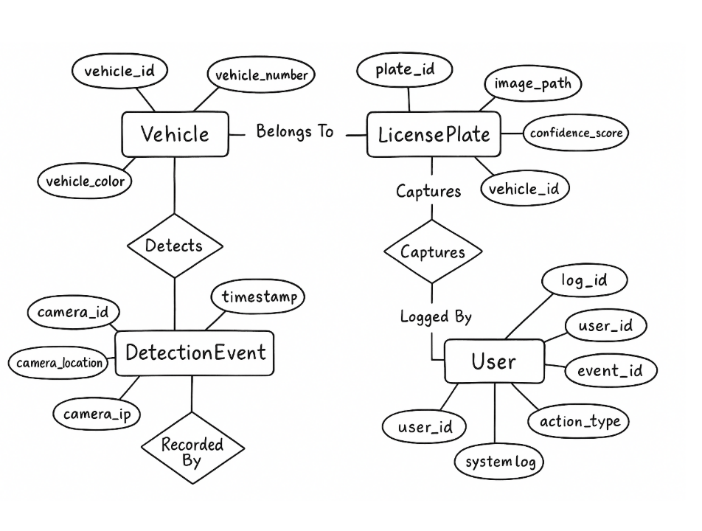
4.2 E-R Diagram
System E-R Diagram

Slide 15
GitHub Link
https://github.com/Adititiwari169
https://github.com/Himanshupatidar2005
https://github.com/Sejalbhawsar26
https://github.com/Aditimodi21

Slide 16
REFERENCES
1.Book
A. Kaehler & G. Bradski, Learning OpenCV 3: Computer Vision in C++, O’Reilly, 2016.R. Szeliski, Computer Vision: Algorithms and Applications, 2nd ed., Springer, 2022.
2. Journal Article
Y. Yuan et al., “A Robust and Efficient Approach to License Plate Detection,” IEEE Trans. Image Process., 2017.
S. Gomathi & N. J. Goldena, “License Plate Recognition Using Machine Learning,” Int. J. Res. Publication Reviews, 2024.
3. Conference Papers
S. Selmi et al., “Real-Time License Plate Recognition System,” Int. Conf. Advanced Technologies for Signal and Image Processing, Tunisia, 2020.
A. Sharma et al., “Automatic Number Plate Recognition using Deep Learning,” IEEE Int. Conf. Computing, Communication and Automation, India, 2021
4. Website
GeeksforGeeks. (2020, Jun. 26). License Plate Recognition with OpenCV and Tesseract OCR
[Online]. Available: https://www.geeksforgeeks.org/machine-learning/license-plate-recognition with-opencv-and-tesseract-ocr/
GeeksforGeeks. (2024, Apr. 22). Automatic Number Plate Recognition System using Computer Vision [Online]. Available:
number-plate-recognition-system/

Slide 17
Thank You
Queries ?

